Slide 1

Company presentation
ØU Life Science –
Investor conference
27 Sep 2023
Clinical-stage company developing disease-modifying treatment for Parkinson’s disease

Slide 2
This company release includes forward-looking statements which are not historical facts but statements regarding future expectations instead. These forward-looking statements include without limitation, those regarding Herantis’ future financial position and results of operations, the company’s strategy, objectives, future developments in the markets in which the company participates or is seeking to participate or anticipated regulatory changes in the markets in which the company operates or intends to operate. In some cases, forward-looking statements can be identified by terminology such as “aim,” “anticipate,” “believe,” “continue,” “could,” “estimate,” “expect,” “forecast,” “guidance,” “intend,” “may,” “plan,” “potential,” “predict,” “projected,” “should” or “will” or the negative of such terms or other comparable terminology. By their nature, forward-looking statements involve known and unknown risks, uncertainties and other factors because they relate to events and depend on circumstances that may or may not occur in the future.
Forward-looking statements are not guarantees of future performance and are based on numerous assumptions. The company’s actual results of operations, including the company’s financial condition and liquidity and the development of the industry in which the company operates, may differ materially from (and be more negative than) those made in, or suggested by, the forward-looking statements contained in this company release. Factors, including risks and uncertainties that could cause these differences include, but are not limited to risks associated with implementation of Herantis’ strategy, risks and uncertainties associated with the development and/or approval of Herantis’ drug candidates, ongoing and future clinical trials and expected trial results, the ability to commercialize drug candidates, technology changes and new products in Herantis’ potential market and industry, Herantis’ freedom to operate in respect of the products it develops
(which freedom may be limited, e.g., by competitors’ patents), the ability to develop new products and enhance existing products, the impact of competition, changes in general economy and industry conditions, and legislative, regulatory and political factors. In addition, even if Herantis’ historical results of operations,
including the company’s financial condition and liquidity and the development of the industry in which the company operates, are consistent with the forward-looking statements contained in this company release, those results or developments may not be indicative of results or developments in subsequent periods.
Forward-looking statement
This company presentation includes forward-looking statements which are not historical facts but statements regarding future expectations instead. These forward-looking statements include without limitation, those regarding Herantis’ future financial position and results of operations, the company’s strategy, objectives, future developments in the markets in which the company participates or is seeking to participate or anticipated regulatory changes in the markets in which the company operates or intends to operate. In some cases, forward-looking statements can be identified by terminology such as “aim,” “anticipate,” “believe,” “continue,” “could,” “estimate,” “expect,” “forecast,” “guidance,” “intend,” “may,” “plan,” “potential,” “predict,” “projected,” “should” or “will” or the negative of such terms or other comparable terminology. By their nature, forward-looking statements involve known and unknown risks, uncertainties and other factors because they relate to events and depend on circumstances that may or may not occur in the future.
Forward-looking statements are not guarantees of future performance and are based on numerous assumptions. The company’s actual results of operations, including the company’s financial condition and liquidity and the development of the industry in which the company operates, may differ materially from (and be more negative than) those made in, or suggested by, the forward-looking statements contained in this company release. Factors, including risks and uncertainties that could cause these differences include, but are not limited to risks associated with implementation of Herantis’ strategy, risks and uncertainties associated with the development and/or approval of Herantis’ drug candidates, ongoing and future clinical trials and expected trial results, the ability to commercialize drug candidates, technology changes and new products in Herantis’ potential market and industry, Herantis’ freedom to operate in respect of the products it develops (which freedom may be limited, e.g., by competitors’ patents), the ability to develop new products and enhance existing products, the impact of competition, changes in general economy and industry conditions, and legislative, regulatory and political factors. In addition, even if Herantis’ historical results of operations, including the company’s financial condition and liquidity and the development of the industry in which the company operates, are consistent with the forward-looking statements contained in this company release, those results or developments may not be indicative of results or developments in subsequent periods.

Slide 3

Herantis – at a glance
Herantis Pharma plc was founded in Helsinki, Finland in 2008; Listed at Nasdaq First North Helsinki
Developing disease-modifying treatment to address the unmet clinical need in Parkinson’s disease and other neurodegenerative diseases
Lead asset HER-096 is a small engineered peptide molecule with a unique mechanism of action and subcutaneous injection as an easy route of administration
Phase 1a clinical study ongoing; Safety and blood-brain barrier (BBB) penetration data in healthy volunteers expected in Q4 2023
Experienced board and management team; Scientific advisory board with globally leading experts in Parkinson’s disease from industry and academia

Slide 4

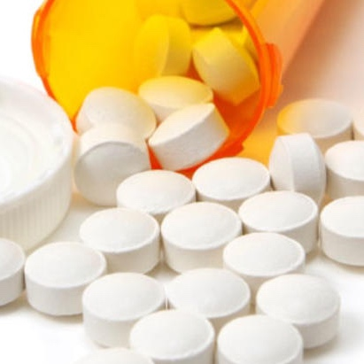
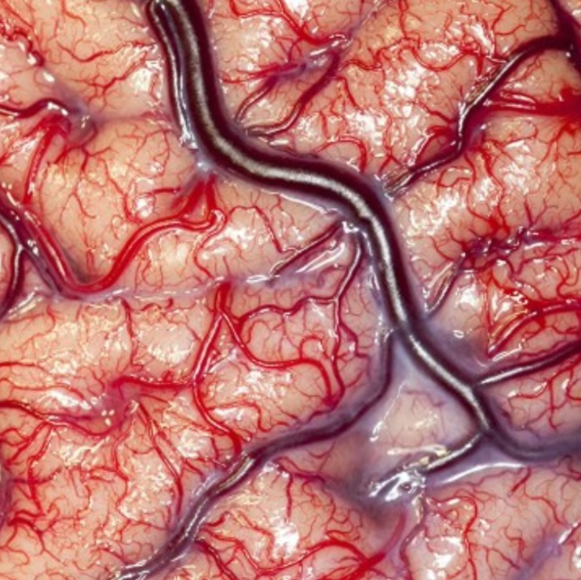


The unmet clinical need in Parkinson’s disease
BLOOD-BRAIN BARRIER (BBB) PROTECTS THE BRAIN – DIFFICULT TO DELIVER DRUGS TO THE TARGET TISSUE
Most pharmaceuticals cannot pass the BBB
Many promising therapeutic candidates cannot be administered to patients so that they would reach the targets in the brain
PARKINSON’S DISEASE (PD)
Degeneration of dopaminergic nerve cells in mid brain cause severe motor and non-motor symptoms
At the time of diagnosis, approximately half of the dopaminergic activity is lost
CURRENT TREATMENTS CANNOT STOP THE PROGRESSION OF PD
For 50 years, the mainstay of Parkinson’s treatment has been levodopa, which helps to restore dopamine levels in the brain
UNMET NEED:
DISEASE-MODIFYING TREATMENTS
AIMS OF HER-096
Slow down or stop the process of mid brain neuron degeneration at early stage of the disease
Preventing the Parkinson’s disease-related symptoms to get worse
OVER $10B MARKET
8-10 million patients globally
Current market $5B
Market estimated to grow to $11B by 2029 driven by disease-modifying treatments (source: GlobalData)

Slide 5
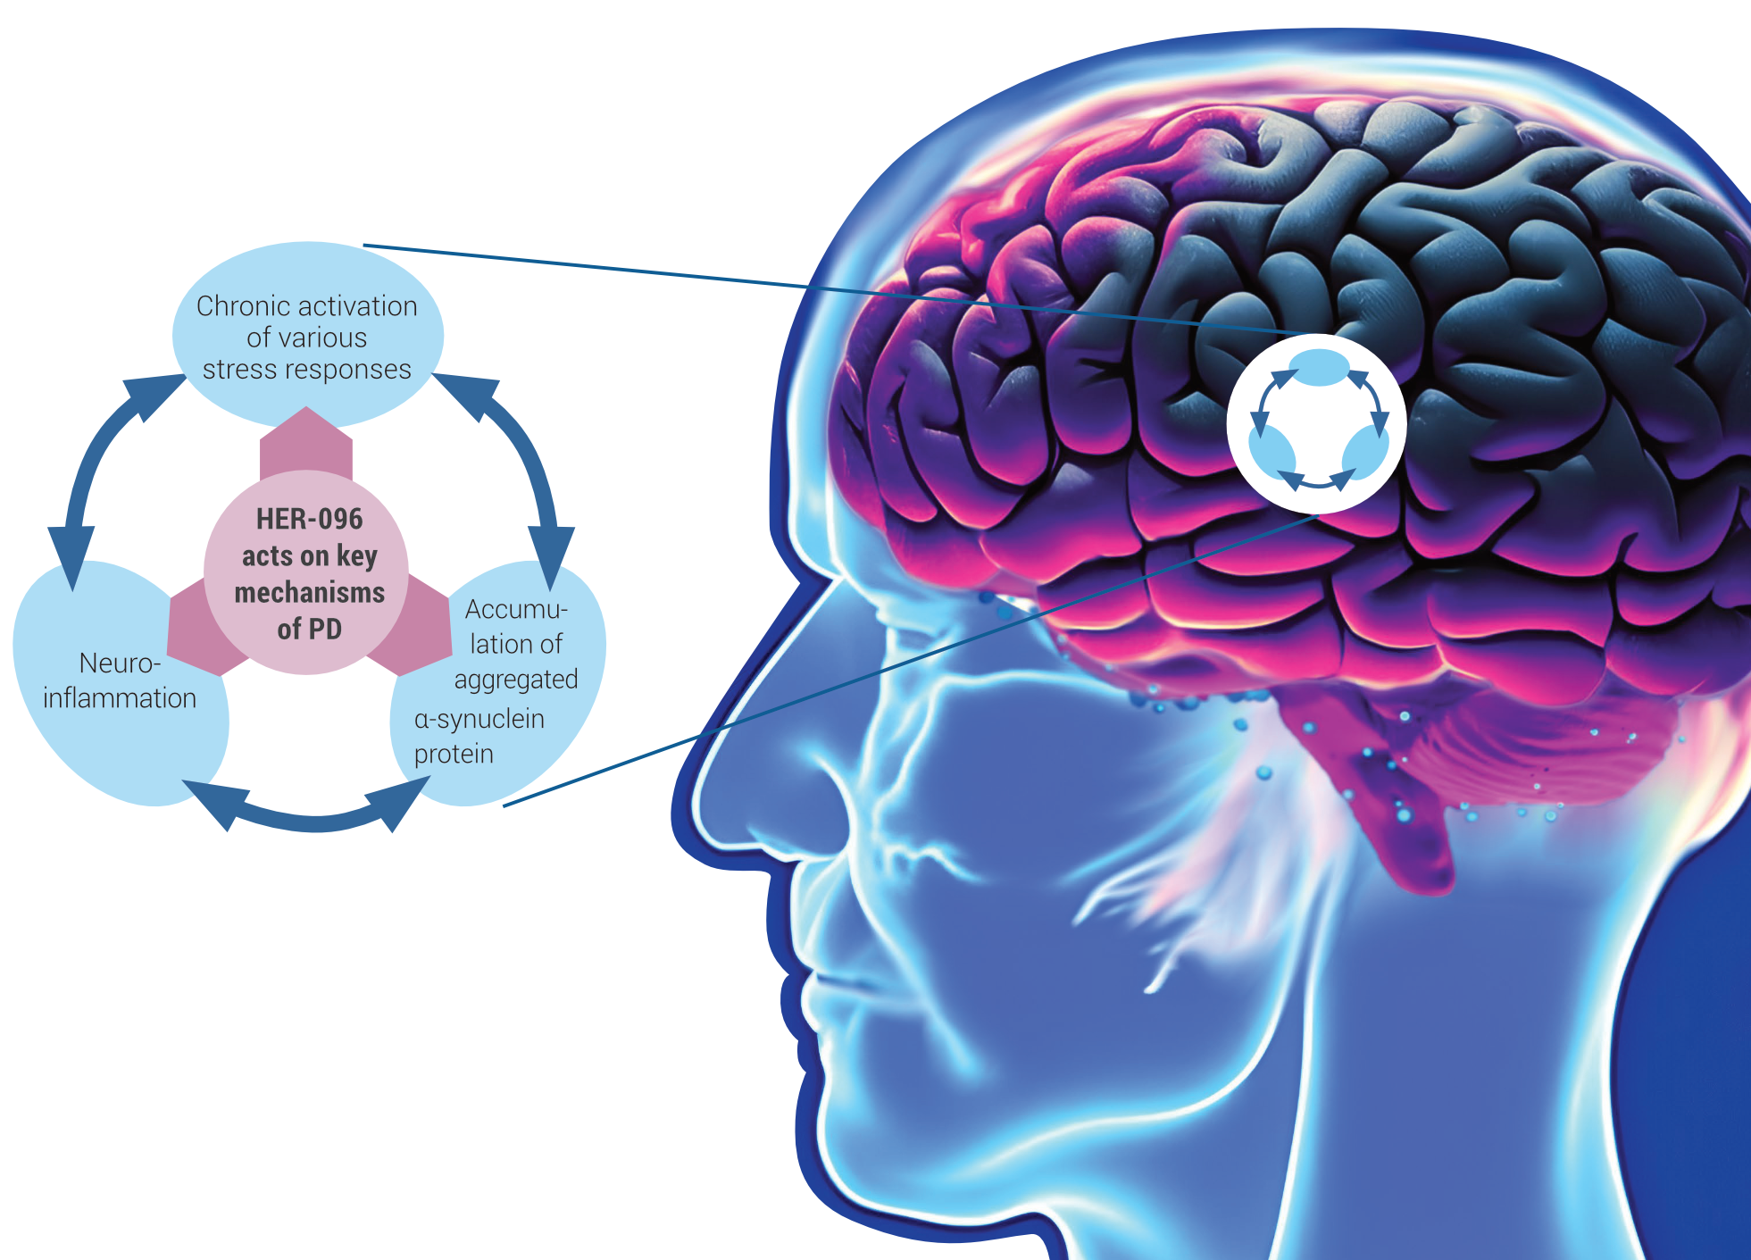
HER-096: A unique MoA targets Unfolded Protein Response (UPR) pathway

Slide 6
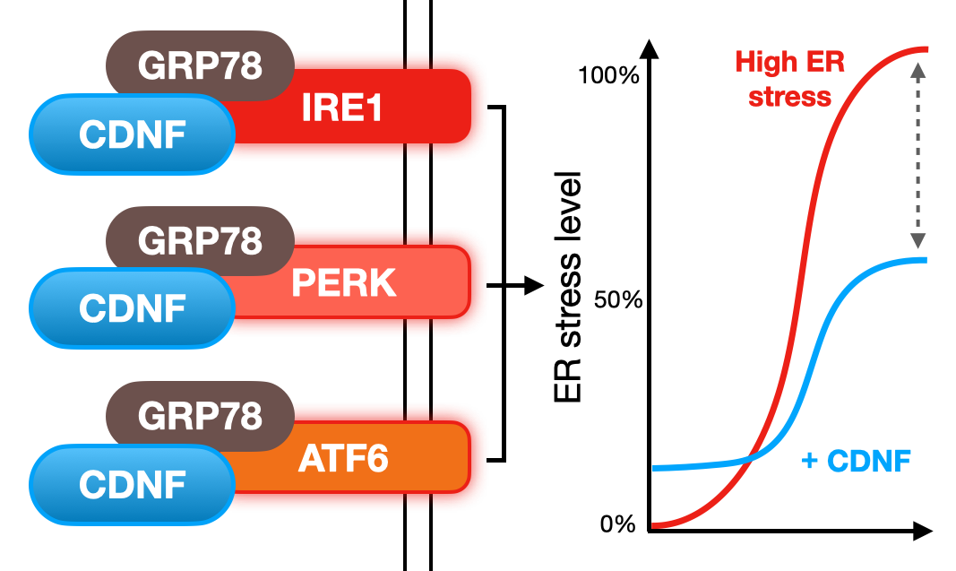
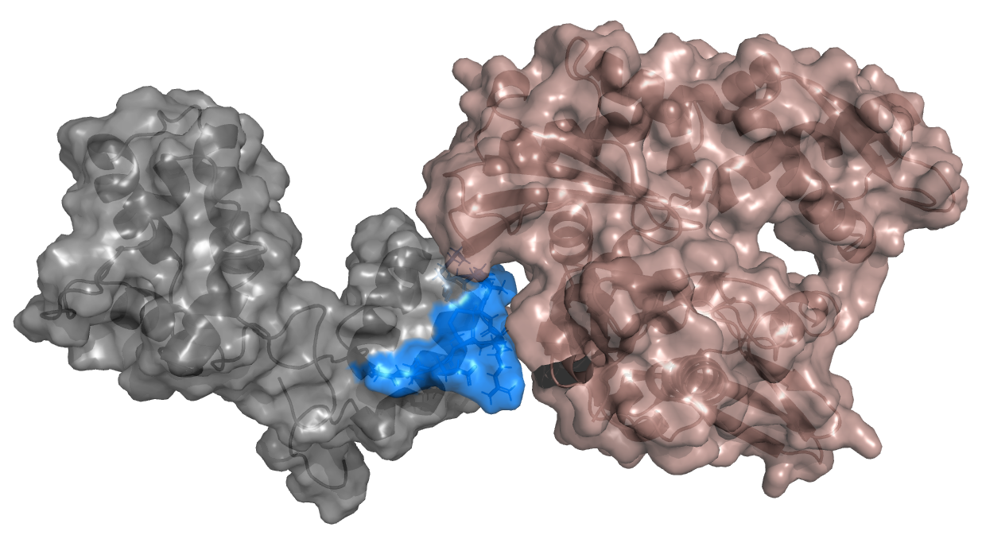
The HER-096 Site in CDNF Binds to the Regulatory Domain of GRP78, the Master Regulator of UPR Signaling
Nucleotide-binding regulatory domain of GRP78
CDNF
Active site
of CDNF corresponding to HER-096
Herantis unpublished data.
Collaboration with EMBL SAXS unit.
CDNF also interacts with the ER lumenal domains of the UPR receptors IRE1α, PERK and ATF6

Slide 7
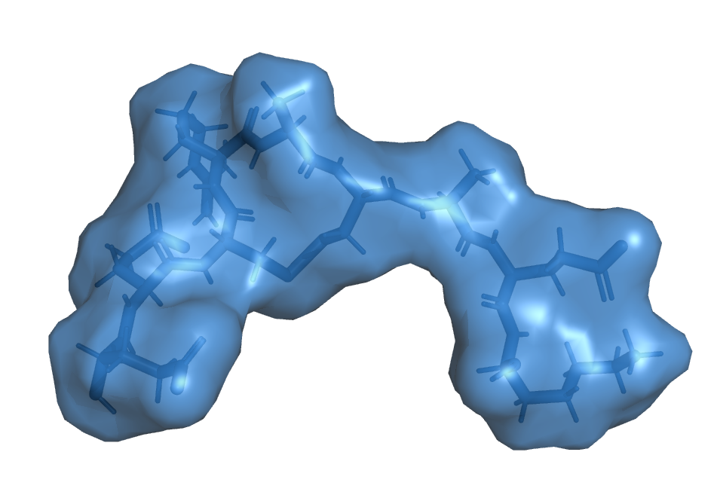
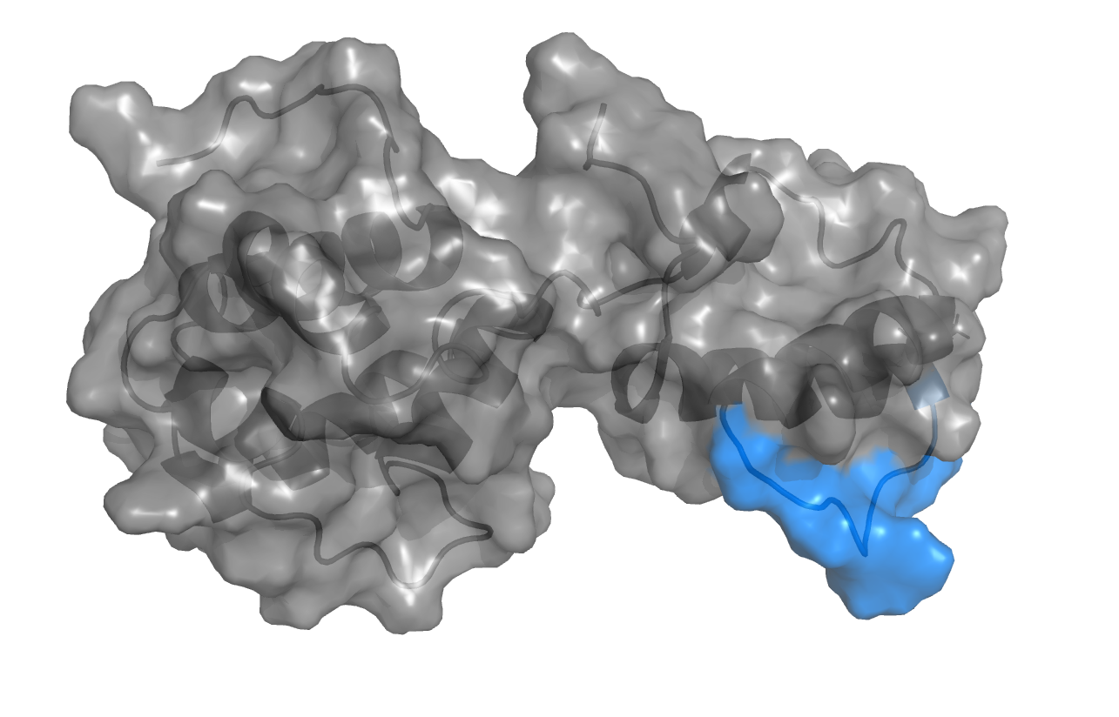
HER-096 is a perfect drug candidate for Parkinson’s disease
Designed based on the active site of CDNF, a known ER protein and unfolded protein response (UPR) modulator
Restores proteostasis and reduces neuroinflammation
Synthetic peptidomimetic molecule, straightforward CMC
HER-096
HER-096
OPTIMIZATION
Effectively passes through the blood-brain barrier in vivo with extended CSF to plasma half-life (s.c. administration)
In vivo evidence of target modulation and effect on motor functions in an ⍺-synuclein-based animal model
Strong
preclinical
evidence
ACTIVE
SITE
Preclinical toxicology studies (GLP) completed (rats, dogs) – no signs of systemic toxicity
Phase 1a started in April 2023, read-out expected in Q4 2023 (safety, blood-brain barrier penetration)
Progressing
in clinical
development
CDNF PROTEIN

Slide 8
Subcutaneous administration of HER-096: Efficient brain penetration
DUAL (BRAIN AND PLASMA) MICRODIALYSIS STUDY IN RATS
Plasma T_{1/2} = 0.5 h
Brain ISF T_{1/2} = 1.3 h
HER-096 therapeutic
level: > ~1 ng/ml
Brain ISF C_{max} = 185 ng/ml (> 180 nM)
Brain ISF AUC_{(0-inf)} = 529 ng/ml*h
Brain ISF T_{1/2} = 1.3 h
Plasma C_{max} = 1637 ng/ml
Plasma AUC_{(0-inf)} = 2450 ng/ml*h
Plasma T_{1/2} = 0.5 h
STUDY SETUP: Male Sprague-Dawley rats with microdialysis probes placed in the striatum and jugular vein were subcutaneously injected with 5 mg/kg HER-096 and microdialysate samples were collected for 5 h at 30 min intervals. The concentration of unbound compound was detected by LC-MS/MS and the values normalized by recovery efficiency of the microdialysis filter determined by in vitro experiments. n=4. Kp,uu,brain = brain-to-plasma ratio of unbound compound.

Slide 9
In vivo: ⍺-Synuclein-based aged mice model with progressive PD like pathology
Synucleinopathy mouse model
Biomarker changes demonstrate progressive pathology
  18-month old C57BL6 mice
  Injection of α-synuclein oligomers to substantia nigra (SNpc)
  Injections of conduritol B epoxide (CBE: 50 mg/kg i.p., every 2nd day) to inhibit lysosomal GBA activity
  >50% loss of nigrostriatal dopamine neurons after 4 weeks, modest behavioral phenotype
  Robust induction dopamin loss, neuroinflammation, ER stress, and α-synuclein aggregation
SETUP OF IN VIVO EXPERIMENTS
Stereotaxic injection of
⍺Syn oligomers
HER-096 dosing (s.c.)
0 1 2 3 4 5 6 weeks
CBE dosing (50 mg/kg) every other day, i.p.
Analysis

Slide 10
HER-096 Protects Dopamine Neurons, Decreases ⍺-Synuclein Aggregates and Neuroinflammation in the Mice Model
PROTECTION OF NIGRAL DOPAMINE NEURONS
α-SYNUCLEIN AGGREGATES IN SUBSTANTIA NIGRA
NEUROINFLAMMATION IN SUBSTANTIA NIGRA
Improvement
Improvement
Improvement
STUDY: Test compound HER-096 was administrated subcutaneously at indicated dose levels three times per week for four weeks starting one week after α-synuclein oligomer injection. Animals were sacrificed on day 42 after the model indication, and neuronal survival (TH), alpha-synuclein aggregation and microglial activation (Iba1) in substantia nigra were assessed by immunostaining and automated image analysis (n=5-7). *p<0.05 ANOVA with post-hoc Fisher’s test versus group treated with vehicle (red bars).

Slide 11
Disease-modification results in a symptomatic improvement in the mouse model
DOPAMINE LEVEL IN STRIATUM
IMPROVEMENT OF MOTOR SYMPTOMS
Improvement
Improvement

Slide 12

HER-096 improves motor function in a mouse PD model
Disease modification & improved motor function ➔ potential to become first-in-class treament of Parkinson’s disease

Slide 13
Therapeutic expectations for HER-096
Effects in the target tissue: HER-096 promotes neuronal survival and functional recovery under prolonged stress conditions
  Reduced endoplasmic reticulum (ER) stress level by modulation of the unfolded protein response (UPR) pathway signalling
  Reduced accumulation and toxicity of misfolded protein aggregates
  Reduced inflammatory activity in the affected brain area
Long term effects with disease modification: Slow down or stop the process of midbrain neuron degeneration at early stage of the disease
Shorter term effect with symptomatic relief within months compared to placebo
Subcutaneous administration 1 – 3 times per week: successful therapeutic effect does not require constant presence of HER-096 in the brain
Notes:
Effect Administration

Slide 14
HER-096 Phase 1a study in healthy volunteers
Part 1:
Male, age 20-45 years
Part 2 (ongoing):
Male & female, age >50 years
Objectives:
Safety and tolerability (single dose)
Blood-brain barrier (BBB) penetration
Exploratory biomarkers
SAD Dose-level X=6 2+6M
SAD Dose-level X= 5 2+6M
Single dose, adaptive
CSF collection
n=12-16 M/F
SAD Dose-level X=4 2+6M
Timelines:
Part 1: First healthy volunteers dosed in Q2
Part 2: First healthy volunteers dosed in Q3
Top-line data expected in Q4 2023
SAD Dose-level X=3 2+6M
SAD Dose-level X=2 2+6M
Expected Next steps:
Phase 1b study in PD patients
Additional Phase 2 proof-of-concept study preparations
SAD Dose-level X=1 2+6M

Slide 15
HER-096 summary
What we want to achieve with HER-096
HER-096 to become a treatment to slow or stop the progression of Parkinson’s disease with symptomatic relief
Strong preclinical evidence of subcutaneous HER-096 in PD: efficient brain penetration, robust disease modification, symptomatic effect
Evidence
Next milestone
Q4 / 2023: Safety, tolerability and brain penetration of subcutaneous HER-096 in human (Phase 1a clinical trial readout)
Strategy
Find a global development partner for clinical development and commercialization of HER-096

Slide 16
Contact details
CEO Antti Vuolanto, antti.vuolanto@herantis.com
CFO Tone Kvåle, tone.kvale@herantis.com

